Slide 1
Multimedia & computer visualization
Digital Watermarking –
Final Evaluation
Paweł Zaborowski 251697
Bartosz Gardziejewski 226128
Rafał Grądkowski 194479
Łukasz Obrębski 218249

Slide 2
Digital watermarking
Kind of marker covertly embedded in a signal
In example: audio, video, image
Use to identify ownership of the copyright of such signal
A digital watermark does not change the size of the carrier signal

Slide 3
State of the art
Spatial domain techniques - directly add the watermark to pixel values - exploit Human Visual System for hiding the data
Transformed domain techniques - add the watermark to the coefficients of a full-frame transform (DFT, DCT, Mellin, Radon, Fresnell)
Hybrid techniques

Slide 4
Implemented algorithms
LSB – Least Significant Bit
Patchwork technique

Slide 5
LSB
Least Significant Bit
Different kinds of data: text, image, etc
Embeds some information in the original file
Takes the most significant bit from watermark and sets it at the least significant bit in source image
To extract watermark we need to extract least significant bit from outputted image
It is impossible to gain original image from output image only knowing the watermark

Slide 6
Patchwork
Embedding a specific invisible statistic into the image
Two patches (sets of pixels) are chosen, then pixels in one patch are moderately brightened while darkened in the second patch by the same factor
To determine which pixels will be changed pseudorandom generator is fed with a secret key shared by both the transmitter and the receiver
The decoding algorithm has to visit the very same points in the same order to extract the embedded data

Slide 7
Features & technologies
Primary features
Additional features
Watermarking image with given watermark picture with LSB algorithm
Watermarking image with Patchwork algorithm
Watermarking image with given text using LSB algorithm
Ability to transform the image and check if watermark persisted
GUI
Technologies
PyCharm
Python 3.7
NumPy
scikit-image

Slide 8
Milestones & Project plan
11.10.19 – Setup of Trello & GitHub
17.10.19 – Project Kick OFF (first presentation)
14.11.19 – Literature analysis, working Python environment, beginnings of a documentation
28.11.19 – Implementation of embedding digital watermark in images using both algorithms
12.12.19 – Implementation of decoding digital watermark in images using both algorithms
09.01.20 – Juxtaposition and comparison of results
16.01.20 – Project closure (Final presentation, project demo, documentation)

Slide 9
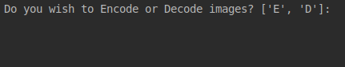
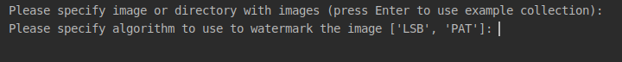
User interface

Slide 10


LSB algorithm
patchwork algorithm

Slide 11
Results

Slide 12

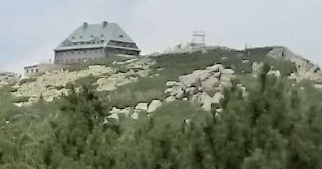

LSB results
Testing images:
Watermark image:

Slide 13
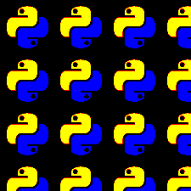
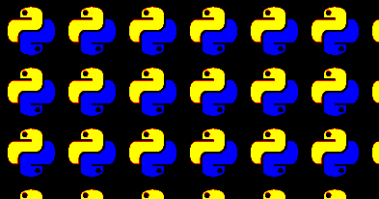
Watermarked image and the watermark extracted from the original

Slide 14

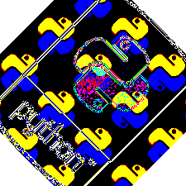
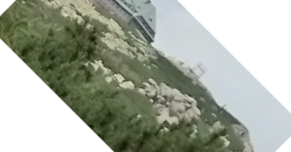
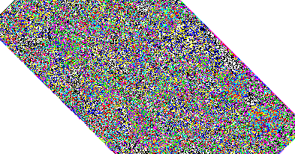
Transformations

Slide 15
LSB – pros & cons
Resistance to geometric transformations, like cropping, stretching or rotating, in condition that the operation is not using more sophisticated algorithm
High capacity of watermark
Fast and easy to implement
Can be easily destroyed by distortions or gamma changes

Slide 16


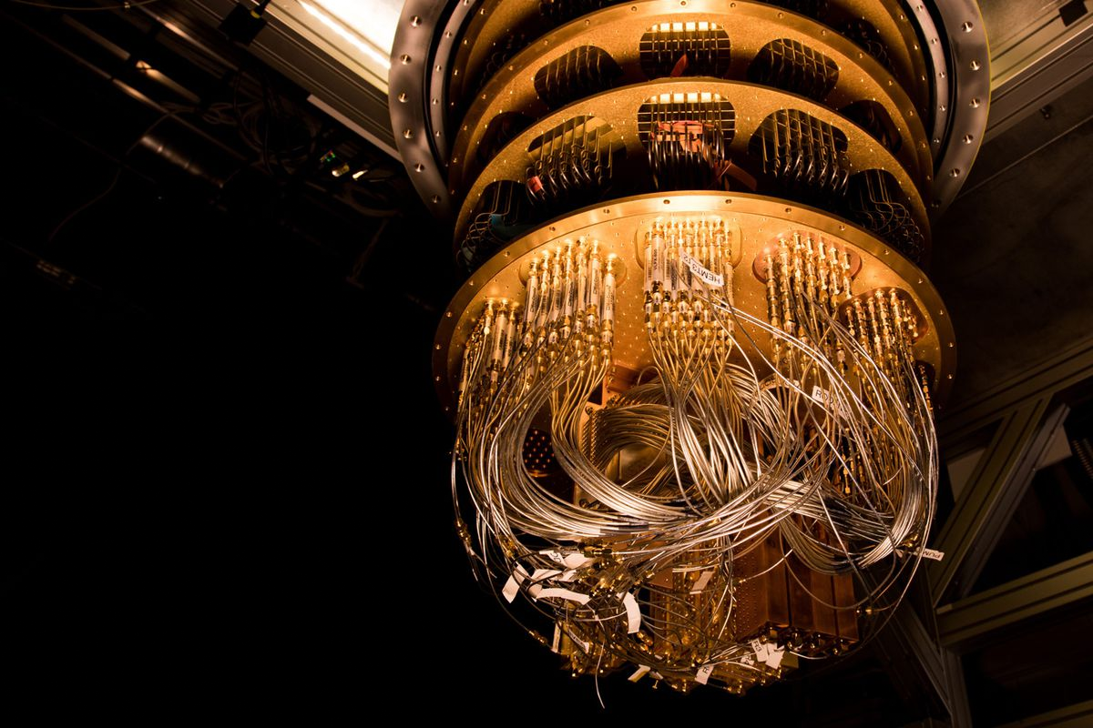

Patchwork results

Slide 17
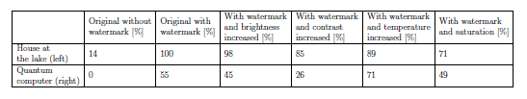
Parameters comparison

Slide 18
Patchwork – pros & cons
Resistance to cropping and to gamma and tone scale corrections
The detector doesn’t require the original cover image to determine whether the image has been watermarked
Can be destroyed by any affine transformation, like translation, rotation or scaling

Slide 19
Thank you for your attention
Questions?

